Slide 1
Department of mechanical 18MEP201L-MINOR PROJECT-I
Zeroth review-09.09.2023
AUTOMATIC SEED SOWING MACHINE
TEAM
KABINESH
KANISHKAR K
KANNYA DHARSHINI V
GUIDED BY:
Dr M MOHANPRASAD
HEAD OF MECHANICAL DEPARTMENT

Slide 2
ABSTRACT
In this process of farming it take more time and energy too.
It is one time investment for the user
Today’s technology should help the farmers.
By this we have developed a equipment which save their time and energy is AUTOMATIC SEED SOWING MACHINE.
For handling this machine the user doesn’t need to literated is the basic benefit .

Slide 3
OBJECTIVE
The main objective of this project is to help the farmer to no to worry
about the effect of sowing the seed.
This machine made out with raw materials so it is affordable.
It is user friendly for Indian farmers to operate.
It reduces man power.

Slide 4
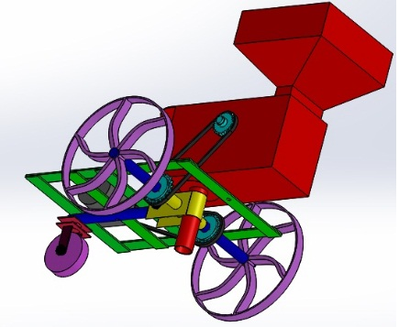
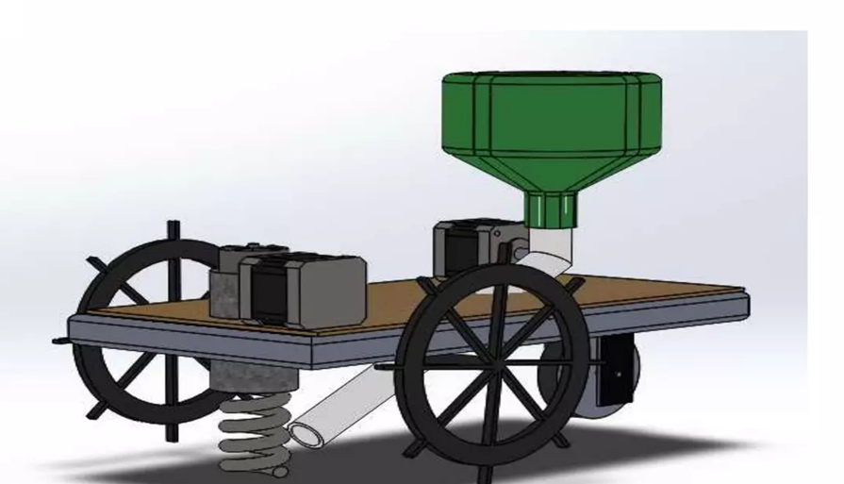
Block diagram

Slide 5
COMPONENTS USED:
FRAME
CHAIN
DC MOTOR
FUNNEL
WHEEL
STORAGE SPACE
BATTERY OR SOLAR PANEL
JOINTS & FIXTURES
SCREWS

Slide 6
PROGRESS PLAN
ZEROTH REVIEW: Deciding the topic and make or alter in our project
FIRST REVIEW : Buying the product to implement the project product
SECOND REVIEW: Assemble the project to work on the field
FINAL REVIEW : Submitting the project porotype and project review

Slide 7
ADVANTAGES
Fully Automatic Seed Sowing
Efficient and Fast Farming
Portable Robot

Slide 8
THANK YOU

